Slide 1

A Comparison of Graph-Based Recommendation System with
Classical Recommendation Methods
By: Anshul Rawat, Arunkumar Rajendran,
Ragini Chugh, Zhilin Xu
Notes:
We have implemented a novel graph based recommendation system. (for recommending businesses to users)
We will first go over a few classical recommendation methods and then compare the results of our method with the classical methods.

Slide 2
1
Model-Based Technique – SVD
2
Item-Based Technique – Attribute Similarity
3
Latent Dirichlet allocation (LDA)
CONTENTS
4
Neural Network Technique
5
User-Based Technique – kNN
6
Graph-Based Technique – Random Walk
7
Result Comparison
8
Conclusions
Notes:
Most recommendation systems use one of these 4 methods
Model based , 2. User based, 3. item based (or) 4. using neural networks

Slide 3
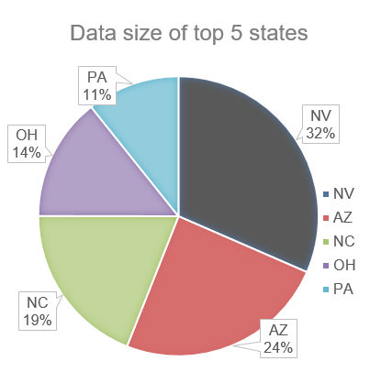
0 Preparation
Preparing the data:
Data is first converted to csv format for better visualization
Pennsylvania is chosen for our experiment with 80/10/10 splits for train, validation, and test on user review date, containing 84 K, 27 K, and 65 K reviews ordered chronologically
Stop words are stripped from user review text using nltk library
User star ratings are appended to user review text to provide relevance for users with same ratings
2
Notes:
we convert the data into csv format for easy analysis using spreadsheet tools
we extracted the review data for Pennsylvania and trained our methods on that subset. The dataset size of PA was not too big, so we can run all analysis in our local machines, at the same time it’s not too small so we know our results will be significant
Then we split the data into 80-10-10 for training, validation and test. The split is done per user, ie. the first 80% of the reviews by the user will go into train, the next 10%...

Slide 4
1 Model Based Technique
Procedure:
Construct user-business rating matrix
Train using Alternating Least Squares (ALS) and tune hyperparameters against validation set. Learn the latent vectors for users and businesses.
Predict ratings and top businesses for each user.
Results:
1.39 RMSE for rating prediction
0.57% Hit Ratio
Improvements:
Incorporate business attributes into the model.
Incorporate review text into the model.
Notes:
read the first 3 steps.
this gives us a hit ratio of .57%, which means that .5% of the recommended businesses were in the test set.
we could try to improve this model further by adding business attributes into the model.

Slide 5
2 Item - Based Technique
Procedure:
Create a one hot vector encoding of 16 feature attributes for every business
Ambience - casual, Bike Parking, Business Accepts Credit Cards, Business Parking - street, Has TV, Restaurants Delivery, Good For Meal - breakfast, Good For Meal - brunch, Good For Meal - dessert, Good For Meal - dinner, Good For Meal - latenight, Good For Meal - lunch, Stars, Alcohol, Noise Level, and Price Range.
Find item-item similarity using cosine similarity.
Predict the rating that a user would give to a specific business.
Also predict the value of the attributes for the business.
Results:
0.3226 RMSE and 5.369% Hit Ratio
Improvements:
Using review text for augmenting the similarity score calculation.
2
Notes:
Another approach that we used was the Item based Collaborative Filtering approach. We did a little modification to the traditional Item based CF. For the following 16 feature attributes, we created a one hot vector for each business and then using this encoding we generated the item-item similarity matrix using the cosine similarity as the similarity measure.
Then, using the similarity matrix generated in the previous step, we predict the accuracy of our model by predicting what rating a user would assign to a business.
In case of a new user, we would take the top 10 similar businesses for that business and assign the average rating.
In case of a new business, we would assign the average rating that the user gave to the businesses she has rated. Also, we predicted the values of the attributes in the one hot vector for the business. The results for this are as follows.

Slide 6
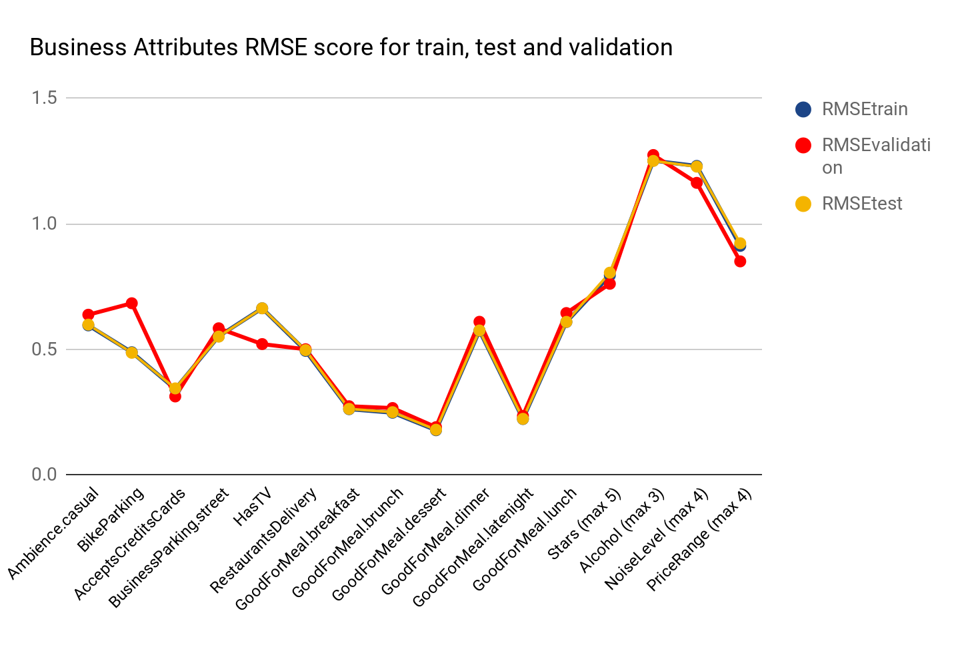
2 Item - Based Technique
2

Slide 7

3 Latent Dirichlet allocation (LDA)
Description:
Classification of similar text in the document into topics.
No of topics: 20
Findings:
LDA topics tend to distribute higher around more frequent terms i.e. topic 1 highest occurence.
Returns likelihood of all topics in a review.
Each review text could be represented by a normalized vector.
Appending star rating to review text led to a non-uniform distribution of topics.
2
“An extra 1/2* rating causes restaurants to sell out 19% points more frequently“

Slide 8
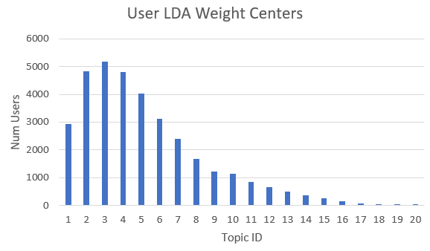
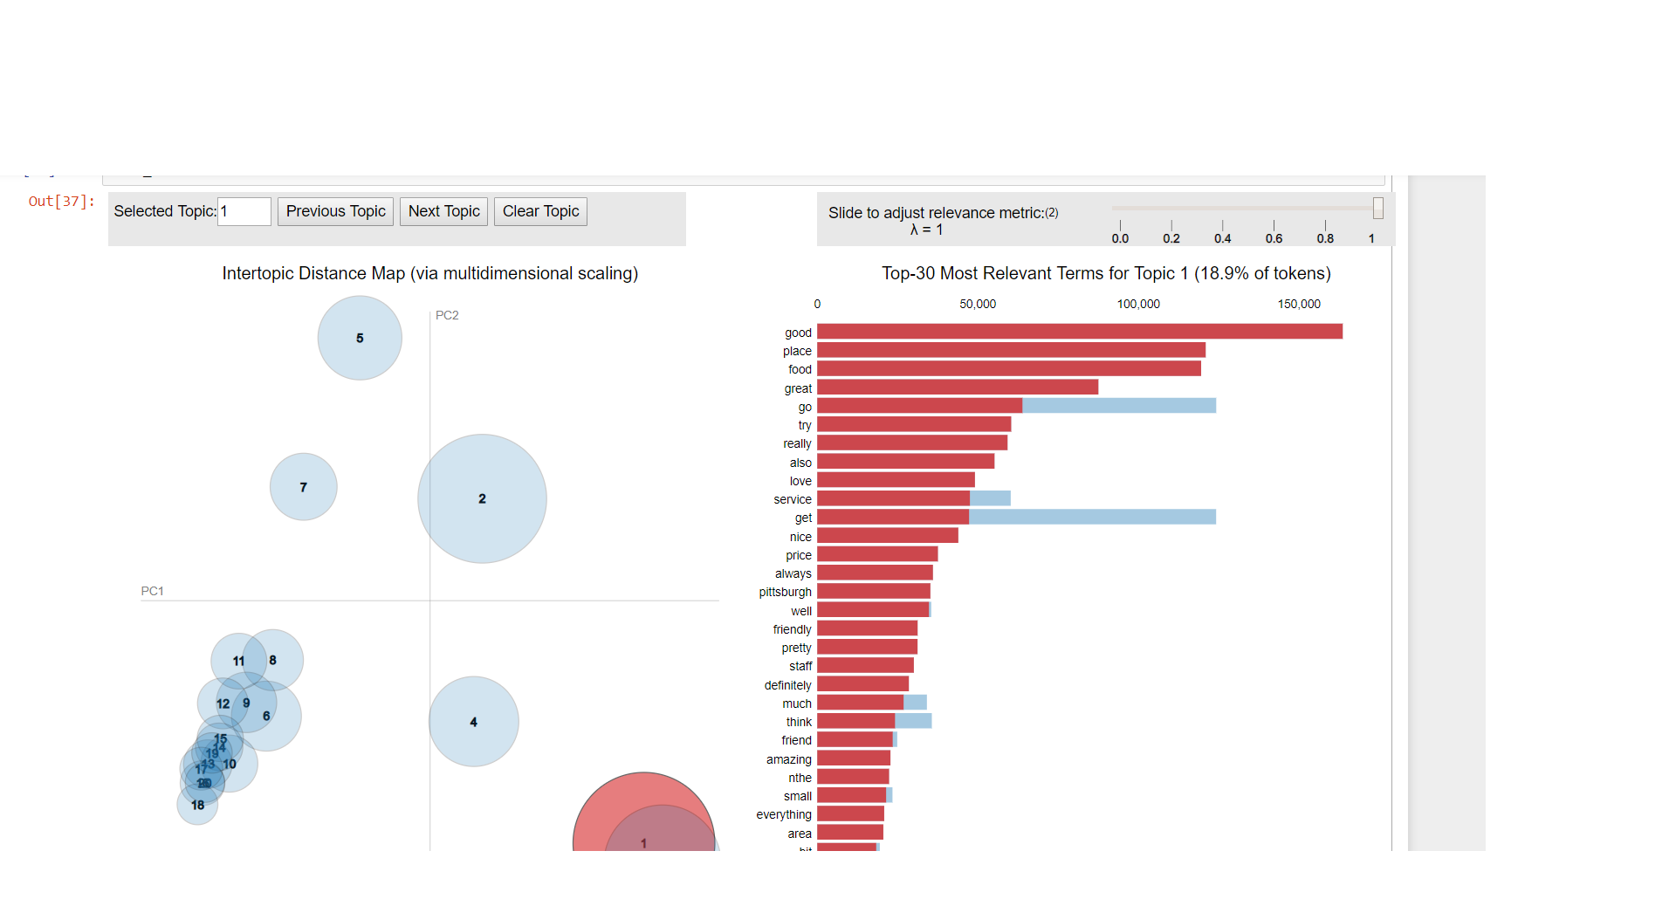
3 Latent Dirichlet allocation (LDA)
Topic | Top Words | Percentage
1 | order,go,food,time,... | 15.6
2 | place,great,service... | 14.9
3 | good,try,love,... | 14.4
4 | restaurant,steak,dinner... | 10.0
5 | mushroom,garlic,downtown,... | 6.6
6 | sauce,bread,fresh,... | 3.8
7 | dish,entree,waiter,... | 3.6
8 | chicken,fry,food,... | 3.3
9 | coffee,business,work,.. | 3.1
10 | table,room,party... | 2.9

Slide 9
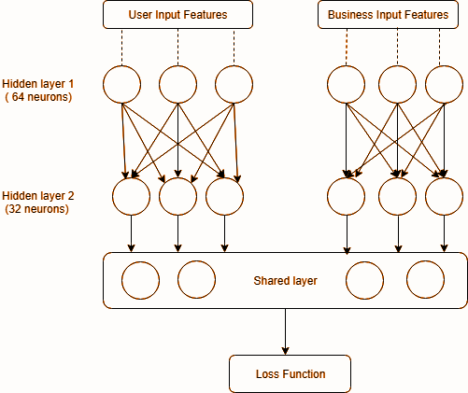
4 Neural Network Technique
Procedure:
Based on LDA results, created a weighted vector of reviews as input feature for users and businesses.
Created a parallel neural network with two hidden layers using keras.
One hot encoding of star rating (1 to 5).
Trained the model and executed once for each prediction variable.
Calculate cosine similarity based on prediction to identify businesses of interest to user.
2

Slide 10
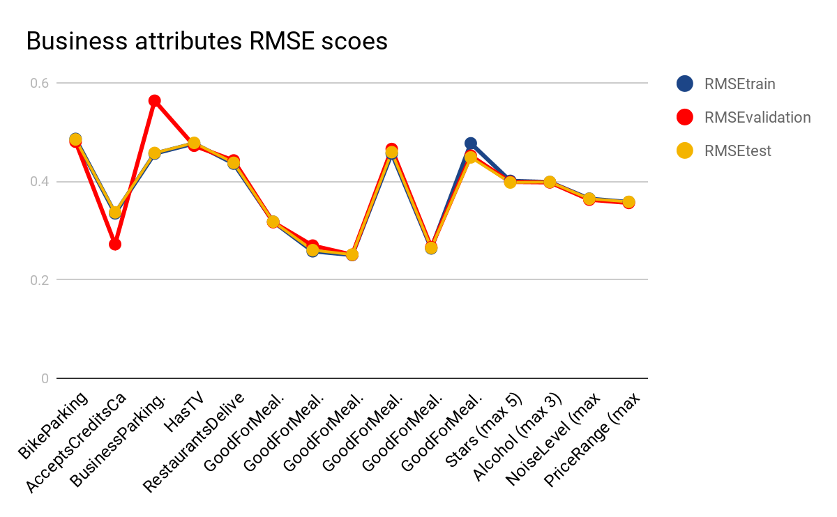
4 Neural Network Technique
RMSE star rating:
0.4

Slide 11
5 User-Based Technique - kNN
Procedure:
Combine review text for each user and compute tf-idf score on vectorized review text with user rating
Find similar user using cosine similarity of text feature vectors
Run prediction with average of similar user’s train business attributes with k = 10 and features = 500
Results:
0.4176 RMSE and 5.188% Hit Ratio
Improvements:
Use user review count & average stars to group users by activeness
Use alternative data source to extract emotions in user review text
Add more hints to salt user review text
1
2

Slide 12
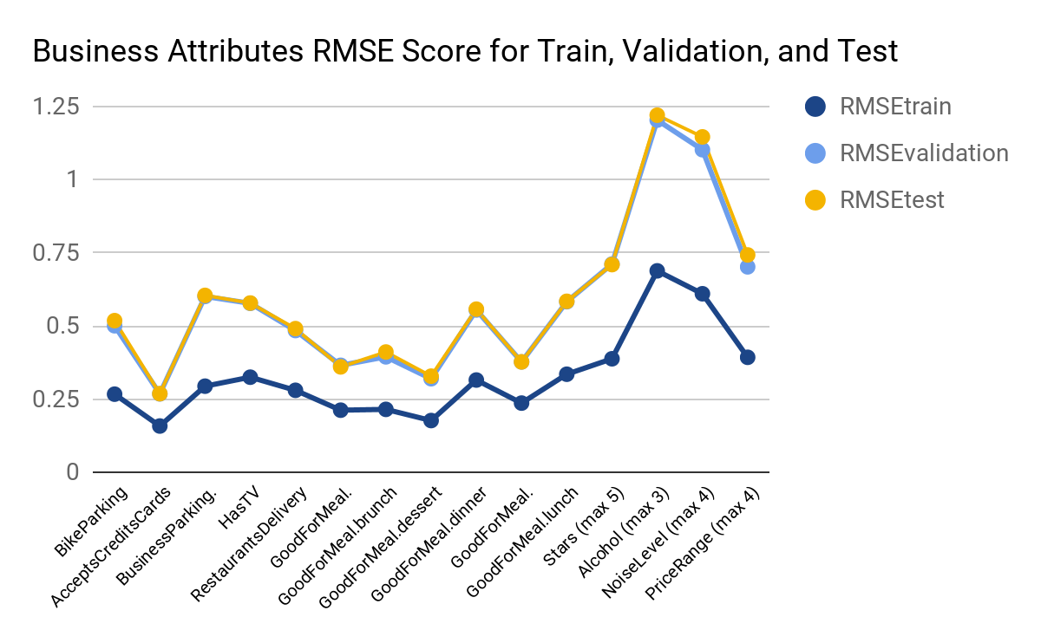
5 User-Based Technique - kNN
1
2

Slide 13
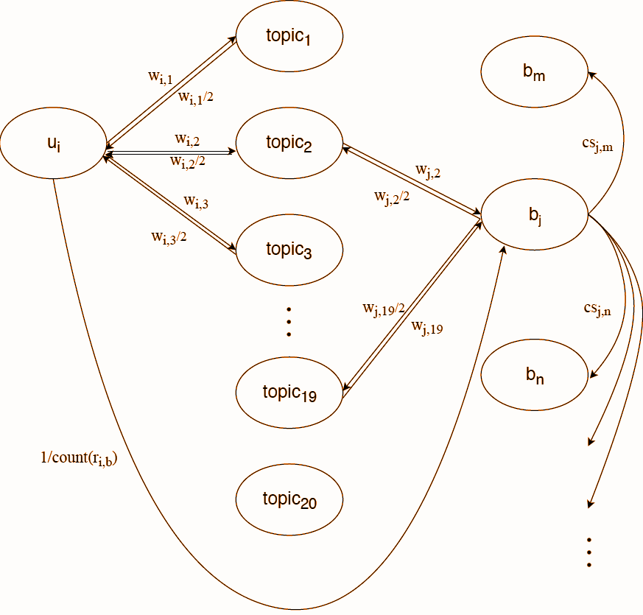


6 Graph Based Technique - Random Walk
Procedure:
Add bidirectional edge between user-LDA topic and business-LDA topic for top 3 scoring LDA topics
Add unidirectional edge from user to business of weights
Add unidirectional edge for every business to its similar 50 businesses with weight
The graph contains 40638 nodes and 326474 edges
The algorithm is run on walker step of 5000 and restart alpha value of 0.05

Slide 14

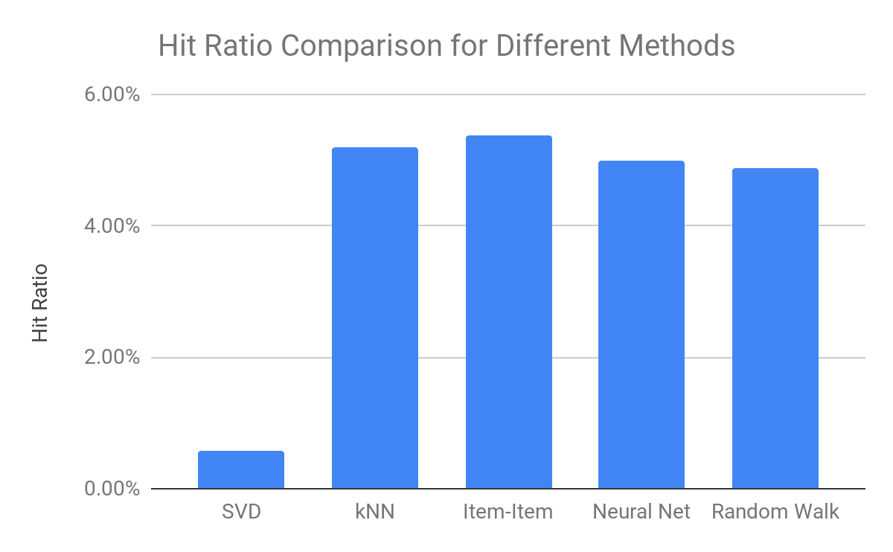
7 Result Comparison
Computing Hit Ratio:
Explanations:
SVD does not take business attributes into consideration.
Tuning graph configuration are difficult compared to adjusting hyperparameters of classical methods
User preference may be associated with hidden data such as personality or friend recommendations

Slide 15
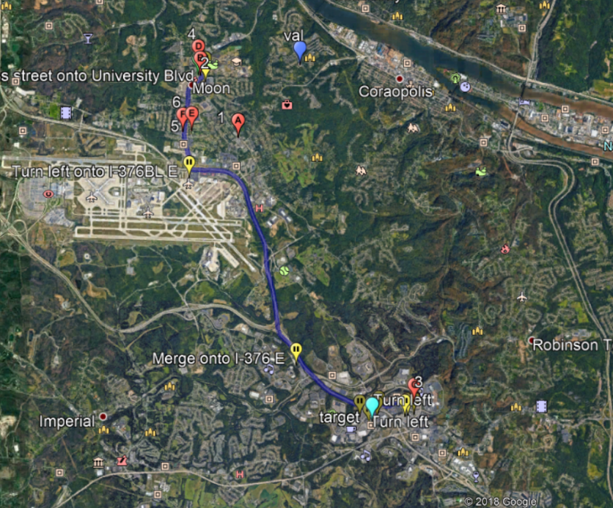
8 Conclusion
Validation
RMSE scores from classical methods gave similar results
Random walk is able to find exact business labels without the aid of any similarity metrics
Random walk technique did not have significant difference from traditional technique, which is highly associated with tuning the graph
Location based analysis was not included in the experiment as it is applicable to all methods
7.7 miles
Test

